Slide 1
The gall bladder and bile duct :
Anatomy:
Pear shape , 7.5 – 12 cm in length .
Capacity > 50 ml .
Fundus , body , neck & infundibulum .
cystic duct ( 2.5 cm , 0,5 cm ) join common hepatic duct ( 2.5 cm ) to form CBD. ( 7.5 cm )
Blood supply : cystic artery from Rt. Hepatic artery .
Caterpillar turn : Tortuous Rt. Hepatic artery in front of origin of cystic duct with short cystic Ar.
Lymphatics : two ways ;
1- To cystic L.node of lund →coeliac L. N.
2- Directly to liver .
Physiology :
Bile →97% water
→2% bile salt
→1% bile acid and cholesterol.

Slide 2
Bile production : 40 ml / hour = 1000 ml /day .
Gall bladder function :
1- Reservoir & storage.
2- Concentration of bile 5-10 times .
3- secretion of mucin ; 20 ml / day .
Investigations of biliary tract :
Plain Xray :
Radio opaque stone 10 – 20 %.
Porcelain gall bladder .
Limey bile .
Gas in biliary tree.
2) Oral cholecystography & iv. Cholangiography.
Out of use .
Historical interest.
3) Ultrasonography :
Prime test .
Standard test .
Quick , non-invassive test .
4) ERCP. & endoscopic ultrasonography . 5) PTC .
6) MRCP (standard, no contrast).

Slide 3
7) Radio isotope scanning :
99mTC labelled HIDA , IODIDA . Iv. given , excreted in bile, gall bladder visualised 30 minute if delayed to 1 hour suggest acute cholangitis or contracted gall bladder ( chronic ) .
8) CT. Scan :
To detect liver and pancreatic lesion .
Cancer extent and staging .
L. Node enlargement .
9) Per operative cholangiography .
10) Per operative choledochoscopy :
Flexible fibreoptic endoscope to localize and extract stone .

Slide 4
Congenital abnormalities of GB. & bile ducts :
1- Abscence of G.B.
2- Phryngian cap 2 – 6 % , phrygian cap like hats of people of phrygia (asia Minor). Suptum in G. bladder either complete or incomplete .
3- Intra hepatic G.B.
4- Floating G.B. → torsion .
5- Double G.B
6- Cystic duct anomalies : Intra hepatic ;
Accessory duct .
Low insertion .
Short or absent.
Extra hepatic biliary Atresia :
1/14000 live births .
Occlusion of variable length .
inflamation → destruction → fibrosis → obliteration .
Out come :
Biliary cirrhosis .
Portal hypertension .
Jaundice .
Liver failure

Slide 5
Types :
Type I occlusion of C.B.D.
Type II C.B.D. + C.H.D.
Type III C.B.D. + C.H.D. + Lt. & Rt. H.d.
Clinical features :
1- Jaundice at birth – progressive –
2- Pale muconium.
3- Dark urine .
4- Steatorrhoea leading to Osteomalacia( biliary rickets ).
5- Clubbing of fingers .
6- Portal hypertension .
7- Another anomalies in 20% .
DDx:
1- Neonatal jaundice .
2- Choledochal cyst .
3- Inspissated bile syndrome .
4- Neonatal hepatitis.
Rx : Early surgery Roux-en-Y or liver transplant.
Post op. Complications :
1- Cholangitis in 40% .
2- Portal hypertension 50% .

Slide 6
Choledochal cyst :
Def.: Congenital cystic dilatation of biliary tract (particularly CBD).
Clinical features :
1- Jaundice .
2- Rt. hypochondrial cystic mass .
3- Cholangitis & pancreatitis .
Dx :
1- ultrasound diagnostic test .
2- MRCP.
Px : Premalignant → cholangiocarcinoma .
Rx : Surgical excesion & Roux-en-Y .

Slide 7
Gall Stone
Features | Cholesterol stone | Mixed stone | Black Pigment S. | Brown pigment S.
location | Gall bladder | Gall bladder | Gall bladder | Bile Duct
Components | Hardened cholesterol (almost pure cholesterol) | Mostly cholesterol (51-99% of stone contents) + calcium salts, bile acids, bilirubin pigments & phospholipid | Mostly Bilirubin pigments+ Ca phosphate+ Ca carbonate+≤ 30% cholestrol | Mainly Ca bilirubinate+Ca palmitate+ Ca stearate +≤ 30% cholestrol
Gross Features | Large solitary, white | Small, hard, multiple, faceted, green or yellow | Small, black, irregular& multiple | Large, brown & single
common possible Aetiology | Same as mixed | Most common Cases in which chol increase or bile acid dec in bile associated with patients with obesity, high caloric diet, contraceptive pills, ileal resection, abnormal emptying of gall bladder | Highly associated with SCA, H spherocytosis& cirrhosis | Associated with bile stasis & infected bile due to FB in bile duct like stent or parasitic infestations like Chlonorichis sinensis or Ascaris lumbricoidis
World distribution | In US and Europe 80% cholesterol or mixed…… around 10% of them is pure Cholestrol stone | In US and Europe 80% cholesterol or mixed…….. Around 70% of them is mixed stone | In US and Europe, both types of pigment stones represent around 20% of total mostly in immigrant people from Asia and Africa. In Asia 80% of . stones are pigment stones (black more than brown | In US and Europe, both types of pigment stones represent around 20% of total mostly in immigrant people from Asia and Africa Common in Asia. In Asia 80% of stones are pigment stones.(black more than brown)
Epidemiology
Female, Fatty, Fertile, Forty
Types
1. Cholesterol and 2. Mixed : 80% in US and Europe
3.Pigmented: 80% in Asia
Aetiology
Metabolic
Stasis
Pregnancy
Infection……H. pylori
Others…….Sickle Cell Anaemia . Heriditry Spherocytosis
(See the diagram below).

Slide 8
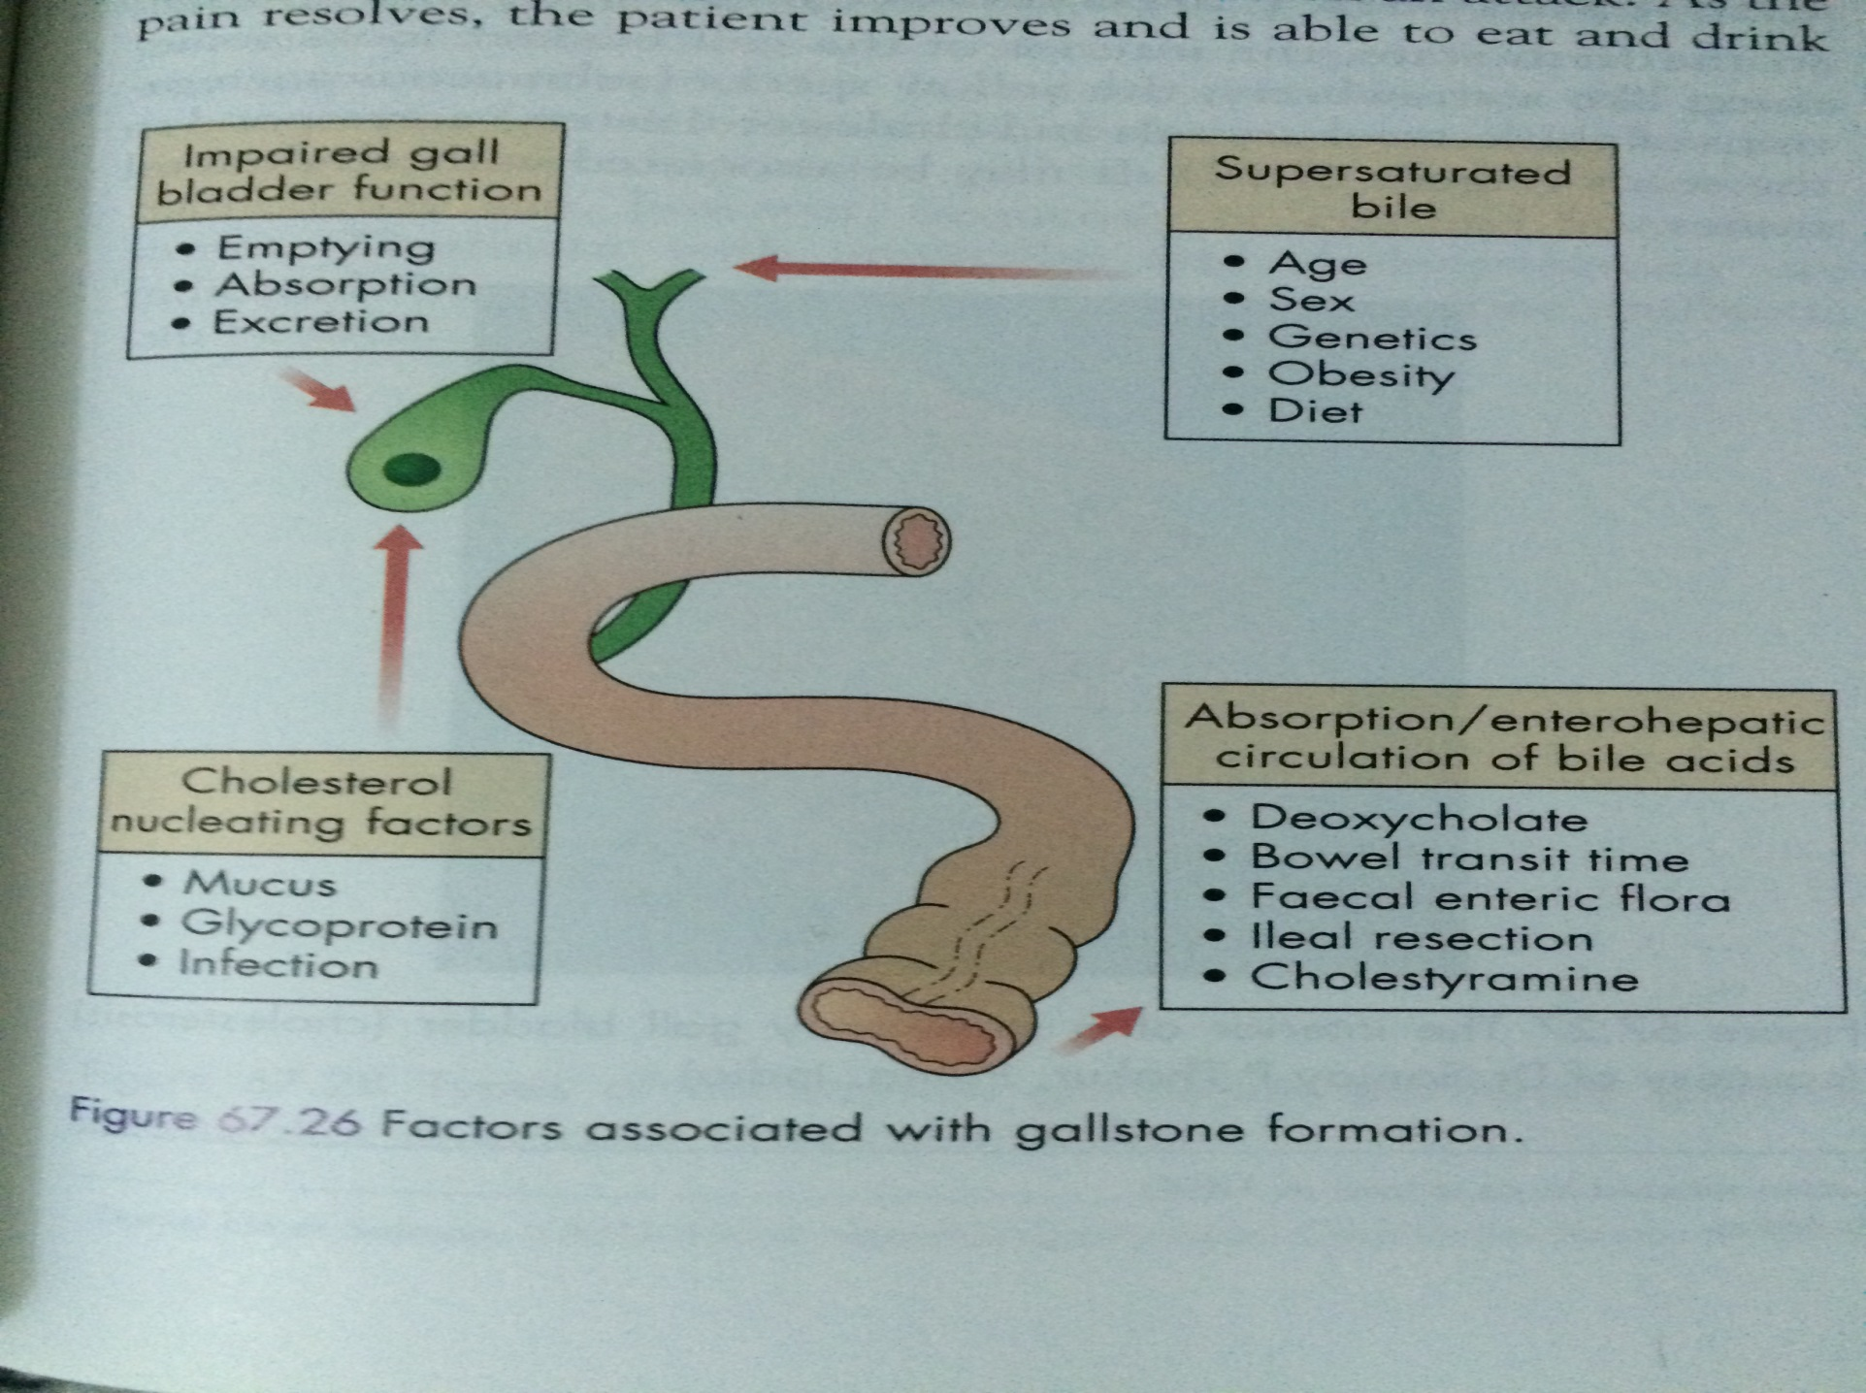
Gall Stone Aetiology

